Slide 1
Estimating the Predictive Accuracy of a Classifier
Course Code: CSC 4139
Course Title: Data Warehouse and Data Mining
Dept. of Computer Science
Faculty of Science and Technology

Slide 2
Estimating the Predictive Accuracy of a Classifier
Lecture Objectives and Outcomes:
This lecture explores the methods of estimating the performance of a classifier.
Three methods are described for estimating a classifier’s predictive accuracy. The first of these is to divide the data available into a training set used for generating the classifier and a test set used for evaluating its performance.
The other methods are k-fold cross-validation and its extreme form N-fold (or leave-one-out) cross-validation.

Slide 3
Estimating the Predictive Accuracy of a Classifier
Lecture Objectives and Outcomes:
A statistical measure of the accuracy of an estimate formed using any of these methods, known as standard error is introduced.
A tabular way of presenting classifier performance information called a confusion matrix is introduced
Apply WEKA Tool for solving different Data Mining tasks
Review Mid-term Syllabus

Slide 4
Introduction
Any algorithm which assigns a classification to unseen instances is called a classifier.
Predictive accuracy -> The proportion of a set of unseen instances that it correctly classifies.
Other criteria are also important, such as algorithmic complexity.

Slide 5
Introduction
Three main strategies (training/test):
Dividing the data into training and test set
K-fold cross validation
N-fold (leave one out)cross validation

Slide 6
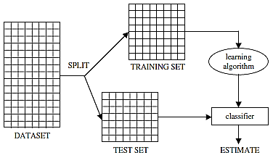
Method 1: Separate Training and Test Sets
Data is split into two parts called a training set and a test set
Training set is used to construct a classifier
The classifier is then used to predict the classification for the instances in the test set.
If the test set contains N instances of which C are correctly classified
Predictive accuracy, P = C/N

Slide 7
Standard Error
Predictive accuracy (estimate of the true predictive accuracy) is calculated from sample data
True predictive accuracy could be calculated if we can use ALL unseen data
Which is impossible
We can use statistical method to find a range of values within which the true value of the predictive accuracy lies with a specific probability of “confidence level”
So how can we predict/range of the true predictive accuracy?

Slide 8

Standard Error
Using statistical methods to find a range of values within which the true value of the predictive accuracy lies, with a given probability or ‘confidence level’.
To do this we use the standard error associated with the estimated value p

Slide 9

Standard Error
Confidence Level (CL)
Standard Error (Z_{CL})
The true predictive accuracy lies in the interval :
If N=100, and C=80, so P=80/100=0.8
Standard Error =
Now we can say with probability 0.95 (confidence level) the true predictive accuracy lies in the interval 0.8 ± 1.96 × 0.04 i.e. between 0.7216 and 0.8784.

Slide 10

Standard Error
The predictive accuracy of a classifier is often quoted as in technical papers as just without any multiplier ZCL.
So 0.8 ± 0.04

Slide 11

Repeated Train and Test
Repeat k times:
K : test sets
N : samples at each trial/test
P: average accuracy
If test sets are not all same size:
If there are N_{i} instances in the ith test set (1 ≤ i ≤ k) and the predictive accuracy calculated for the ith test set is P_{i}
The overall predictive accuracy p is:
P is weighted average of P_{i}

Slide 12
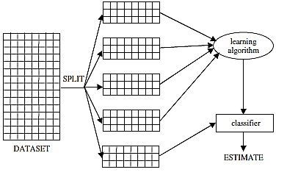
K-fold Cross Validation
Dataset comprises N instances
Divided into k equal parts, k typically being a small number such as 5 or 10. (If N is not exactly divisible by k, the final part will have fewer instances than the other k − 1 parts.)
Each of the k parts in turn is used as a test set and the other k − 1 parts are used as a training set.
Selection bias is minimized
Usually K = 5 to 10

Slide 13
N-fold Cross Validation
N-fold cross-validation is an extreme case of k-fold cross-validation
Often known as ‘leave-one-out’ cross-validation or jack-knifing
Dataset is divided into as many parts as there are instances, each instance effectively forming a test set of one.
K=N
e_{1,} e_{1,}…….,e_{n}
Take the average.
High computation is required, but validation way is nice

Slide 14
Experimental Results - I
Predictive accuracy of classifiers generated for four datasets.
All the results in this section were obtained using the TDIDT tree induction algorithm, with information gain used for attribute selection.
More detail on the datasets in the course book, in Appendix B

Slide 15
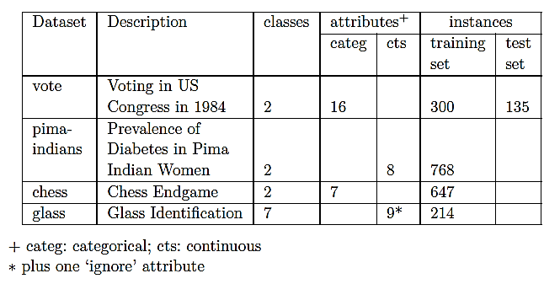
Experimental Results - I

Slide 16
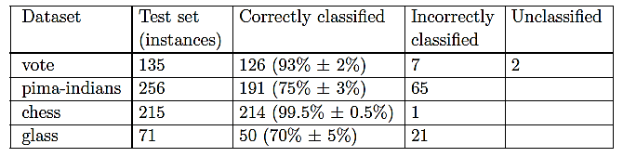
Experimental Results - I

Slide 17
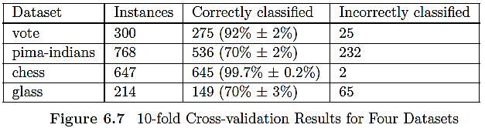
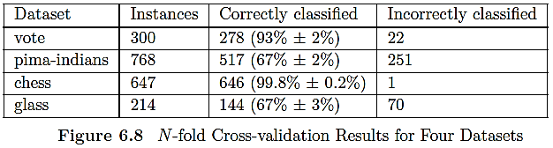
Experimental Results - I
Below results obtained using 10-fold and N-fold Cross-validation for the four datasets.

Slide 18
Datasets with Missing Value
How to deal with missing values?
Two strategies for dealing with missing attribute values were described
Discard Instances
Replace by most frequent/average value

Slide 19
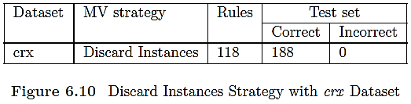
Discard Instances
Discarding data may damage reliability of the resulting classifier
What if the proportion of missing values are large?

Slide 20
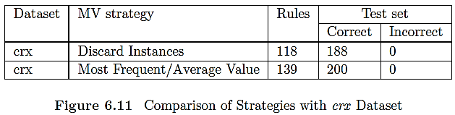
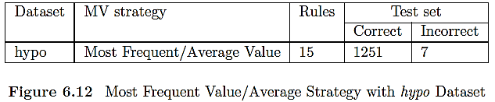
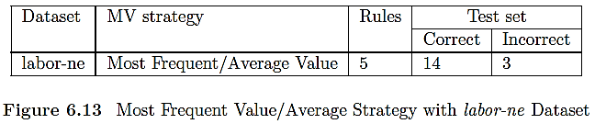
Replace by Most Frequent/Average Value

Slide 21
Confusion Matrix
As well as the overall predictive accuracy on unseen instances it is often helpful to see a breakdown of the classifier’s performance, i.e. how frequently instances of class X were correctly classified as class X or misclassified as some other class.
This information is given in a confusion matrix.

Slide 22
Confusion Matrix
True Positive (TP): The model correctly predicted a positive outcome (the actual outcome was positive).
True Negative (TN): The model correctly predicted a negative outcome (the actual outcome was negative).
False Positive (FP): The model incorrectly predicted a positive outcome (the actual outcome was negative). Also known as a Type I error.
False Negative (FN): The model incorrectly predicted a negative outcome (the actual outcome was positive). Also known as a Type II error.

Slide 23
Metrics based on Confusion Matrix Data
1. Accuracy
Accuracy is used to measure the performance of the model. It is the ratio of Total correct instances to the total instances.
Accuracy=TP+TN/(FP+FN+TP+TN​)

Slide 24
Metrics based on Confusion Matrix Data
2. Precision
Precision is a measure of how accurate a model’s positive predictions are. It is defined as the ratio of true positive predictions to the total number of positive predictions made by the model.
Precision=TP/(FP+TP)​

Slide 25
Metrics based on Confusion Matrix Data
3. Recall
Recall measures the effectiveness of a classification model in identifying all relevant instances from a dataset. It is the ratio of the number of true positive (TP) instances to the sum of true positive and false negative (FN) instances.
Recall=TP/(TP+FN)​

Slide 26
Metrics based on Confusion Matrix Data
4. F1-Score
F1-score is used to evaluate the overall performance of a classification model. It is the harmonic mean of precision and recall
F1-Score=2*Precision*Recall/ (Precision+Recall)​

Slide 27

Confusion Matrix

Slide 28
Confusion Matrix: Example
A 2X2 Confusion matrix is shown below for the image recognition having a Dog image or Not Dog image.
 | Predicted Dog | Predicted Not Dog
Actual Dog | True Positive (TP) | False Negative (FN)
Actual Not Dog | False Positive (FP) | True Negative (TN)
True Positive (TP): It is the total counts having both predicted and actual values are Dog.
True Negative (TN): It is the total counts having both predicted and actual values are Not Dog.
False Positive (FP): It is the total counts having prediction is Dog while actually Not Dog.
False Negative (FN): It is the total counts having prediction is Not Dog while actually, it is Dog.

Slide 29
Confusion Matrix: Example
Example: Confusion Matrix for Dog Image Recognition with Numbers
Index | 1 | 2 | 3 | 4 | 5 | 6 | 7 | 8 | 9 | 10
Actual | Dog | Dog | Dog | Not Dog | Dog | Not Dog | Dog | Dog | Not Dog | Not Dog
Predicted | Dog | Not Dog | Dog | Not Dog | Dog | Dog | Dog | Dog | Not Dog | Not Dog
Result
TP
FN
TP
TN
TP
FP
TP
TP
TN
TN

Slide 30
Confusion Matrix: Example
Example: Confusion Matrix for Dog Image Recognition with Numbers
Actual Dog Counts = 6
Actual Not Dog Counts = 4
True Positive Counts = 5
False Positive Counts = 1
True Negative Counts = 3
False Negative Counts = 1
 |  | Predicted
 |  | Dog | Not Dog
Actual | Dog | True Positive (TP =5) | False Negative (FN =1)
 | Not Dog | False Positive (FP=1) | True Negative (TN=3)

Slide 31
Confusion Matrix: Matrices Values
Accuracy=
TP+TN/ (FP+FN+TP+TN​)
(5+3)/(5+1+1+3)
=8/10
=0.8
Recall=
TP/(TP+FN)
5/(5+1)
=5/6
=0.83
​
Precision=
TP/(FP+TP)
5/5+1
=5/6
=0.83
F1- Score=2*Precision*Recall/ (Precision+Recall)​
(2*.71*.83)/(0.71 +0.83)
=1.179/1.54
=0.766

